Slide 1

Demand Forecasting for a Bike Rental platform

Slide 2

Agenda
Business Problem and Data Introduction – Vishal Agarwal
Exploratory Data Analysis and Visualization – Neil Joshi
Predictive Linear Model Building – Syed Kashif
Assumptions and Diagnostic Analysis – Sharan Salem
Model/ Business Solution and Way Forward– Karan Dalal
Q&A
Sharan Salem - Syed Kashif - Vishal Agarwal - Karan Dalal - Neil Joshi

Slide 3
Motivation
Understanding and Implementing concepts of Linear regressions.
Enabling bike-sharing company to make data-driven demand forecasting.
Aiding inventory management and operations as a result of demand forecasting.
Health, environment and other social parameters
Sharan Salem - Syed Kashif - Vishal Agarwal - Karan Dalal - Neil Joshi

Slide 4
The Questions
For a given set of weather conditions and a specific type of day, how many total users are expected for the company?
Sharan Salem - Syed Kashif - Vishal Agarwal - Karan Dalal - Neil Joshi

Slide 5
The Dataset
Base Data Size: 731 Obs. Of 11 Variables.
Target Variable – Total Count of Bikes Rented
Data abstract: This dataset contains the daily count of rental bikes between years 2011 and 2012 from Capital bikeshare system, Washington D.C., USA with the corresponding weather and seasonal information
UCI ML Repository | wunderground.com
Month | Avg Daily temperature
Season | Humidity
Weekday | Feels Like Temp
Holiday | Windspeed
Weather Condition
Count of total rental bikes
Sharan Salem - Syed Kashif - Vishal Agarwal - Karan Dalal - Neil Joshi

Slide 6
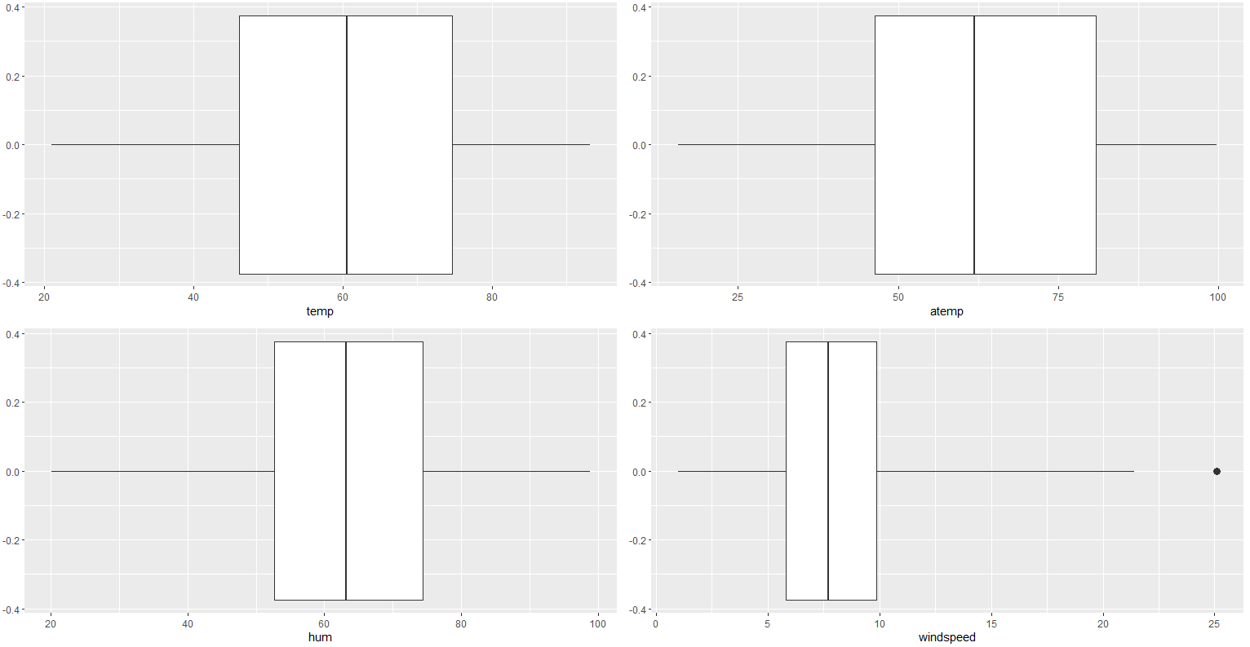
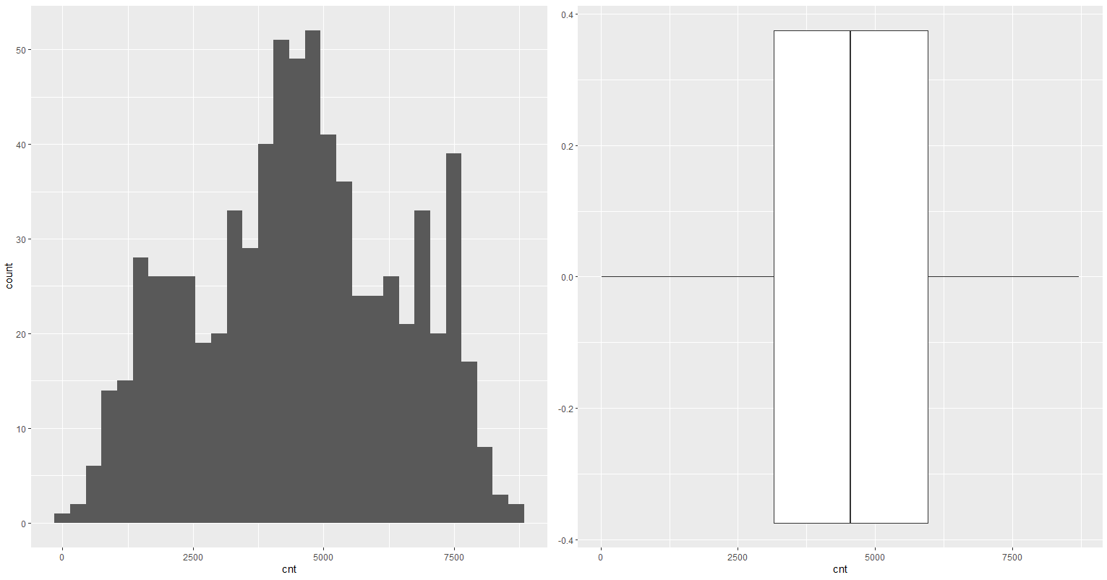
Data Exploration
Outlier Detection in Numerical Variables
Distribution of Target Variable
Sharan Salem - Syed Kashif - Vishal Agarwal - Karan Dalal - Neil Joshi

Slide 7
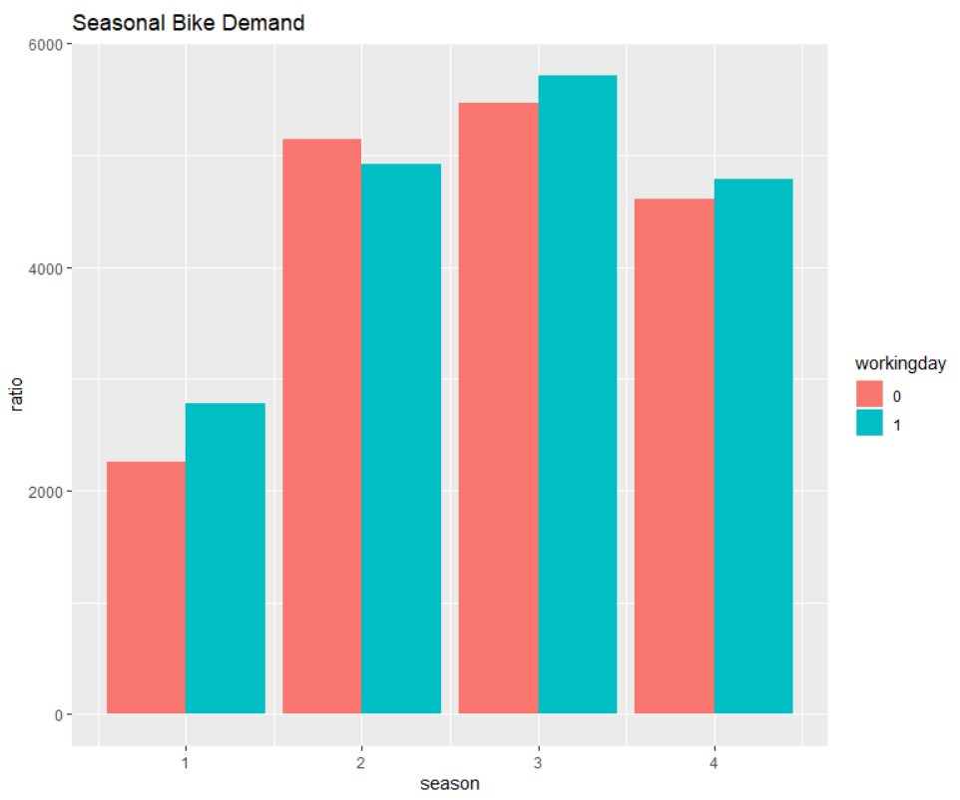
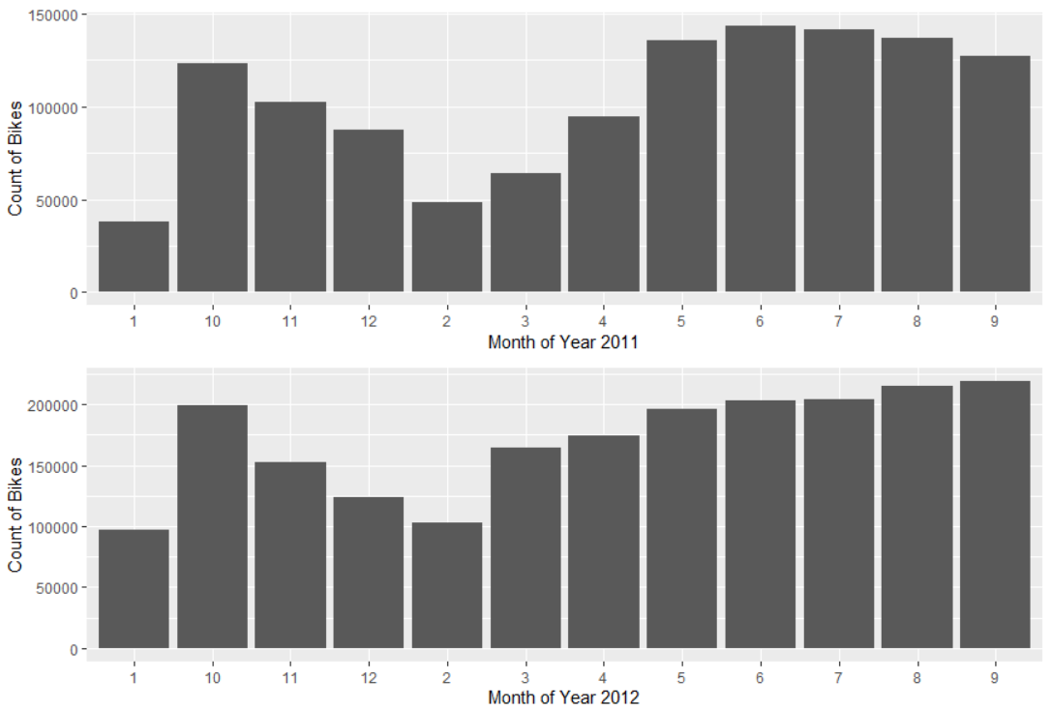
Data Exploration
Seasonal Bike Demand
Month wise Bike Demand
Sharan Salem - Syed Kashif - Vishal Agarwal - Karan Dalal - Neil Joshi

Slide 8
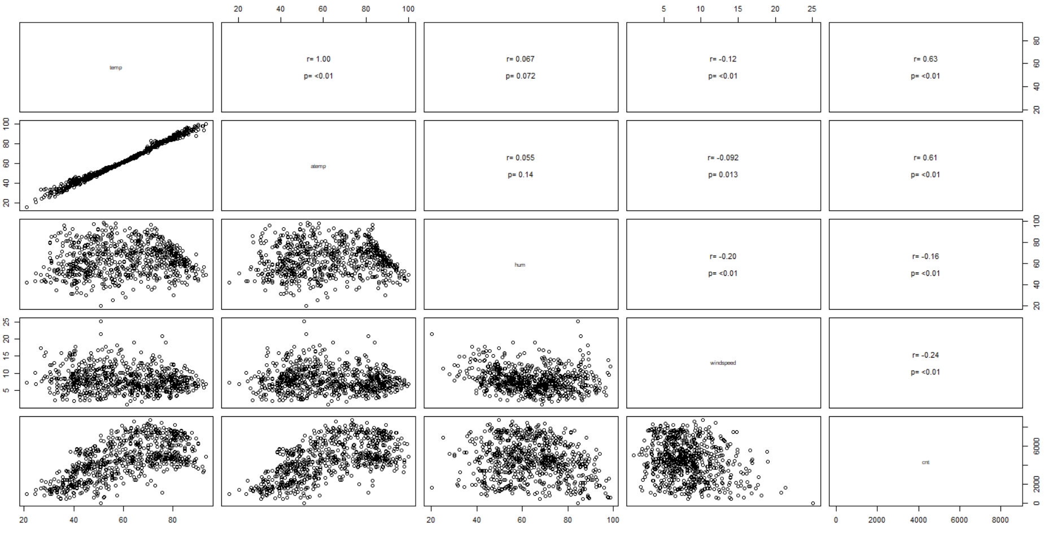
Data Exploration
Temp
aTemp
Humidity
Wind-Speed
Total Count
Correlation Matrix
Sharan Salem - Syed Kashif - Vishal Agarwal - Karan Dalal - Neil Joshi

Slide 9
Linear Regression Model
Initially we created a linear regression model with all the available predictor variables.
Adjusted R-squared: 0.8504
Challenges with full linear regression model:
Heteroscedasticity in distribution of residuals
Positive autocorrelation
Complex model
Low interpretability
Sharan Salem - Syed Kashif - Vishal Agarwal - Karan Dalal - Neil Joshi

Slide 10
Feature Subset Selection
The motivation behind using feature selection:
Reduce model complexity
Improve model interpretability
Prevent overfitting
Improve model performance
We used regsubsets for feature subset selection.
Sharan Salem - Syed Kashif - Vishal Agarwal - Karan Dalal - Neil Joshi

Slide 11
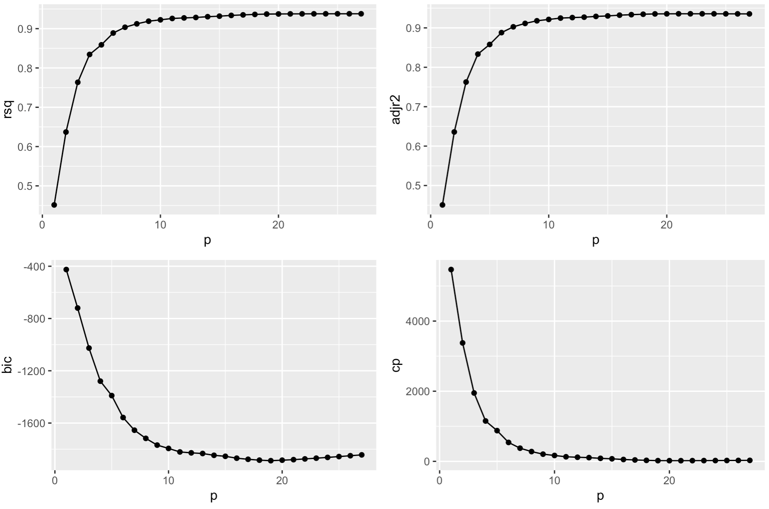
Sharan Salem - Syed Kashif - Vishal Agarwal - Karan Dalal - Neil Joshi

Slide 12
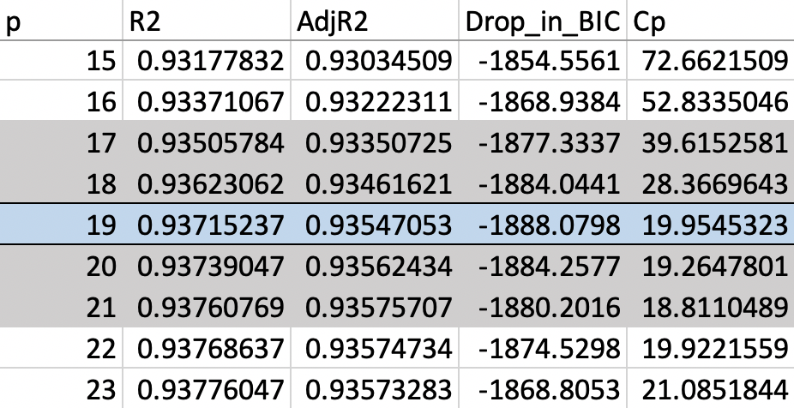
Selecting Best Subset
Sharan Salem - Syed Kashif - Vishal Agarwal - Karan Dalal - Neil Joshi

Slide 13
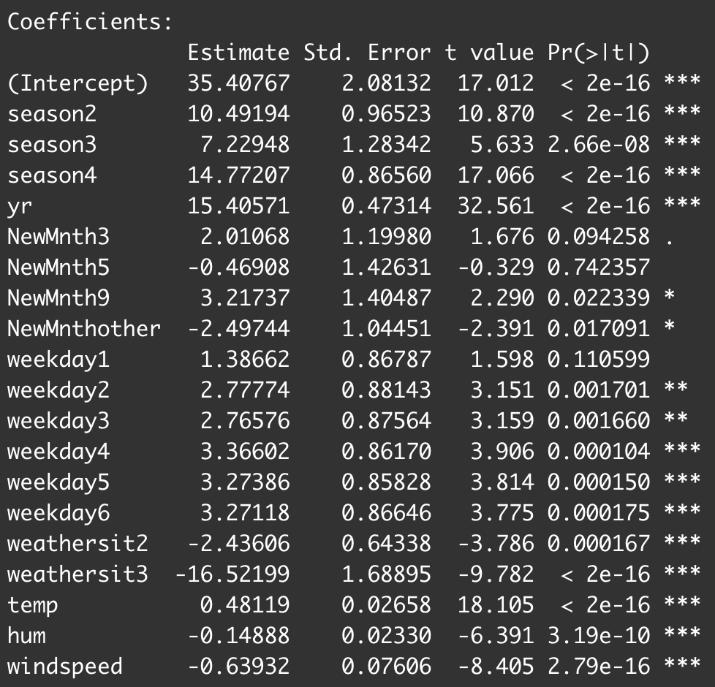
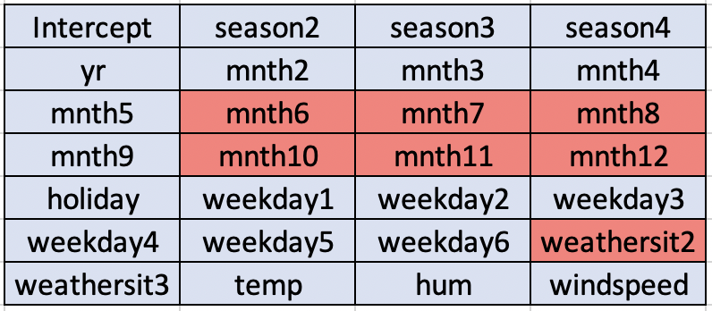
Selected Model
Sharan Salem - Syed Kashif - Vishal Agarwal - Karan Dalal - Neil Joshi

Slide 14
Final Model Transformation
There was funneling effect in the residuals vs fitted graph of the selected model.
To fix this issue, we transformed our selected model by taking square root of the independent variable.
Final Model Equation:
Sqrt(Count) = 35.4 + 10.5*season2 + 7.23*season3 + 14.77*season4 + 15.4*yr1 + 2.01*month3 – 0.47*month5 + 3.21*month9 – 2.5*othermonths + 1.4*weekday1 + 2.77*weekday2 + 2.76*weekday3 + 3.36*weekday4 + 3.3*weekday5 + 3.27*weekday6 – 2.5*Misty – 16.52*lightrain + 0.48*temp - 0.15*hum – 0.64*windspeed
Sharan Salem - Syed Kashif - Vishal Agarwal - Karan Dalal - Neil Joshi

Slide 15
Assumptions – Linear Regression
Assumption 1: Number of observations must be greater than the number of independent variables (n > p).
There are 18 predictors (p) and 657 observations (n).
Hence, this assumption is validated and met.
Sharan Salem - Syed Kashif - Vishal Agarwal - Karan Dalal - Neil Joshi

Slide 16
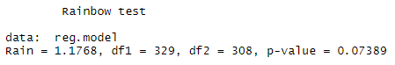
Assumptions – Linear Regression
Assumption 2: Model should be linear.
The idea of Rainbow test is that even if the true relationship is non-linear, a good linear fit can be achieved on a subsample in the middle of the data. The Null Hypothesis is rejected when the overall fit is significantly worse than the fit for the subsample.
Hence, this assumption is validated and met.
Sharan Salem - Syed Kashif - Vishal Agarwal - Karan Dalal - Neil Joshi

Slide 17
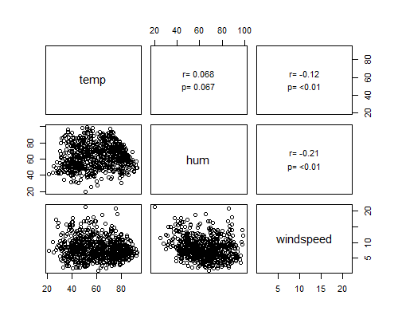
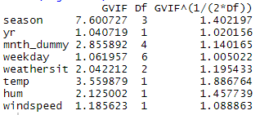
Assumptions – Linear Regression
Assumption 3: Predictors must be independent of each other. No linear relationship (high correlation) between independent variables. No perfect multicollinearity.
Hence, this assumption is validated and met.
Sharan Salem - Syed Kashif - Vishal Agarwal - Karan Dalal - Neil Joshi

Slide 18
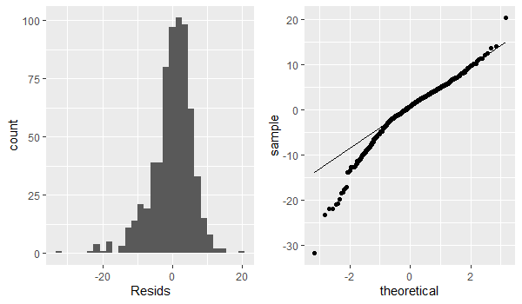
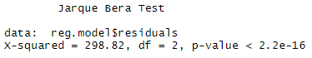
Assumptions – Linear Regression
Assumption 4: Residuals must be normally distributed.
Hence, this assumption is validated and met.
Sharan Salem - Syed Kashif - Vishal Agarwal - Karan Dalal - Neil Joshi

Slide 19
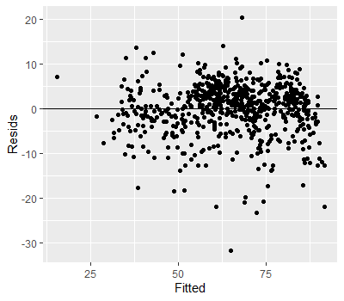
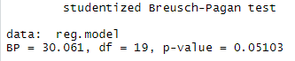
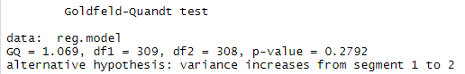
Assumptions – Linear Regression
Assumption 5: Homoscedastic model. Variance in error terms must be constant.
Hence, this assumption is validated and met.
Sharan Salem - Syed Kashif - Vishal Agarwal - Karan Dalal - Neil Joshi

Slide 20
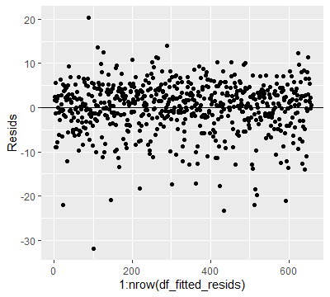
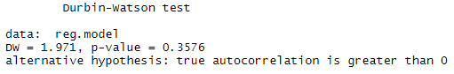
Assumptions – Linear Regression
Assumption 6: Residuals must be independent of each other. No Autocorrelation between errors.
Hence, this assumption is validated and met.
Sharan Salem - Syed Kashif - Vishal Agarwal - Karan Dalal - Neil Joshi

Slide 21
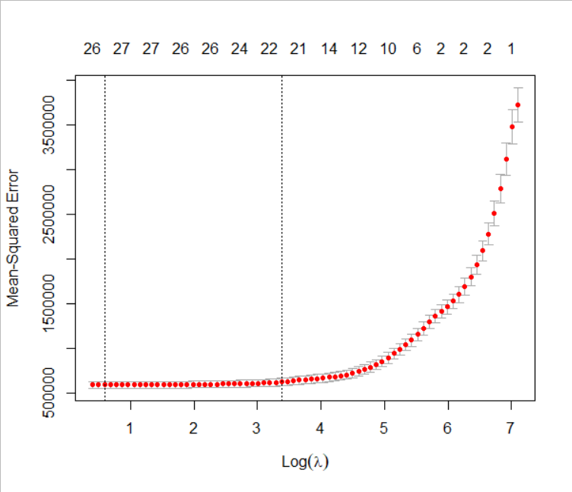
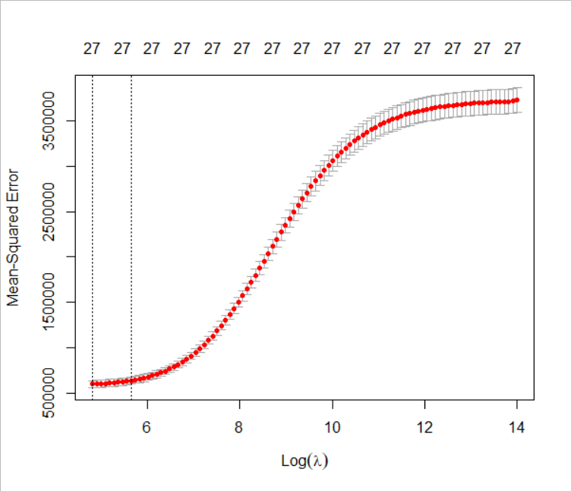
Regularization
1.645246
Lasso Regression
Best Lambda: 1.65
Ridge Regression
Best Lambda: 121.6
Sharan Salem - Syed Kashif - Vishal Agarwal - Karan Dalal - Neil Joshi

Slide 22
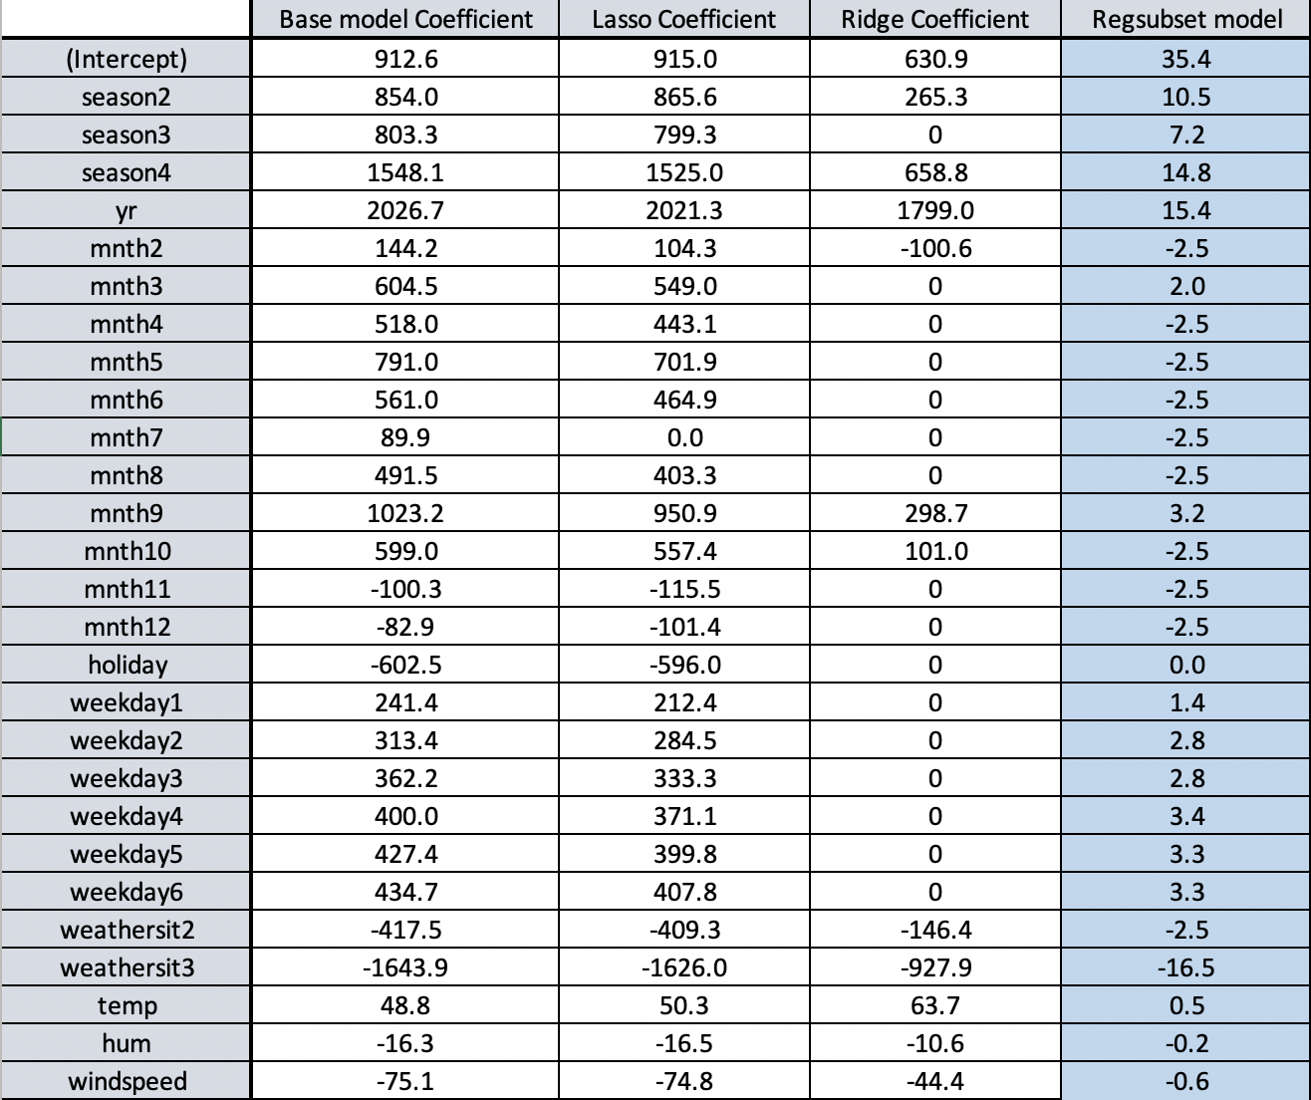
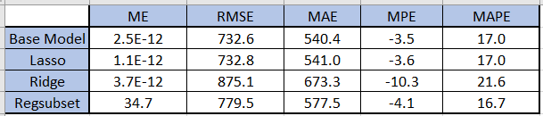
Model Interpretation
Sharan Salem - Syed Kashif - Vishal Agarwal - Karan Dalal - Neil Joshi

Slide 23
Test Cases
Date | Season | Holiday | Weekday | working day | Weather situation | Temp | Feels-like Temp | Humidity | Wind speed | Casual | Registered | Bikes rented |  | Predicted
4/21/2011 | Summer | 0 | 4 | Yes | Clear | 56.9 | 57.6 | 41.4 | 13.6 | 745 | 3444 | 4189 |  | 3542
7/16/2011 | Fall | 0 | 6 | No | Clear | 77.7 | 83.6 | 58.3 | 8.7 | 2418 | 3505 | 5923 |  | 4450
2/26/2012 | Spring | 0 | 0 | No | Clear | 41.3 | 43.0 | 43.1 | 8.5 | 515 | 2874 | 3389 |  | 3462
12/25/2012 | Spring | 1 | 2 | No | Misty | 40.2 | 39.8 | 79.5 | 6.1 | 440 | 573 | 1013 |  | 821

Slide 24
Questions?

